Slide 1
Leadership
Chapter 4 - Style Approach

Slide 2
Overview
Style Approach Perspective
Ohio State Studies
University of Michigan Studies
Blake & Mouton’s Leadership Grid
How Does the Style Approach Work?

Slide 3
Style Approach Description
Perspective
Definition
Comprised of two general kinds of Behaviors
  Task behaviors
    Facilitate goal accomplishment: Help group members achieve objectives
  Relationship behaviors
    Help subordinates feel comfortable with themselves, each other, and the situation
Emphasizes the behavior of the leader
Focuses exclusively on what leaders do and how they act

Slide 4
Ohio State Studies
Leadership Behavior Description Questionnaire (LBDQ)
  Identify number of times leaders engaged in specific behaviors
    150 questions
  Participant settings (military, industrial, educational)
  Results
    Particular clusters of behaviors were typical of leaders

Slide 5
Ohio State Studies, cont’d.
LBDQ-XII (Stogdill, 1963)
  Shortened version of the LBDQ
  Most widely used leadership assessment instrument
  Results - Two general types of leader behaviors:
    Initiating structure – Leaders provide structure for subordinates
      Task behaviors - organizing work, giving structure to the work context, defining role responsibility, scheduling work activities
    Consideration - Leaders nurture subordinates
      Relationship behaviors – building camaraderie, respect, trust, & liking between leaders & followers

Slide 6
University of Michigan Studies
Exploring leadership behavior
  Specific emphasis on impact of leadership behavior on performance of small groups
Results - Two types of leadership behaviors conceptualized as opposite ends of a single continuum
  Employee orientation
    Strong human relations emphasis
  Production orientation
    Stresses the technical aspects of a job
  Later studies reconceptualized behaviors as two independent leadership orientations - possible orientation to both at the same time

Slide 7
Blake & Mouton’s Managerial (Leadership) Grid
Historical Perspective
Leadership Grid Components
  Authority-Compliance (9,1)
  Country Club Management (1,9)
  Impoverished Management (1,1)
  Middle-of-the-Road Management (5,5)
  Team Management (9,9)
  Paternalism/Maternalism (1, 9; 9,1)
  Opportunism

Slide 8
Historical Perspective
Blake & Mouton’s Managerial Leadership Grid
Development
Purpose
Developed in early 1960s
Used extensively in organizational training & development
Designed to explain how leaders help organizations to reach their purposes
  Two factors
    Concern for production
      How a leader is concerned with achieving organizational tasks
    Concern for people
      How a leader attends to the members of the organization who are trying to achieve its goals

Slide 9
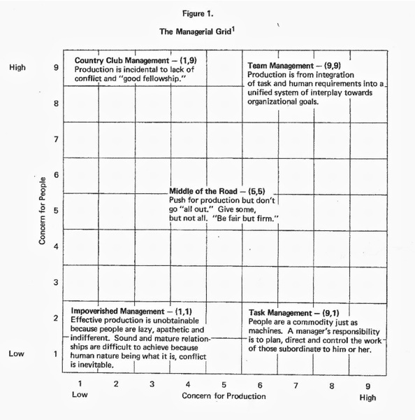
The Leadership Grid

Slide 10
Authority-Compliance (9,1)
Definition
Role Focus
Efficiency in operations results from arranging conditions of work such that human interference is minimal
Heavy emphasis on task and job requirements and less emphasis on people
Communicating with subordinates outside task instructions not emphasized
Results driven - people regarded as tools to that end
9,1 leaders – seen as controlling, demanding, hard-driving & overpowering

Slide 11
Country Club (1,9)
Definition
Role Focus
Thoughtful attention to the needs of people leads to a comfortable, friendly organizational atmosphere and work tempo
Low concern for task accomplishment coupled with high concern for interpersonal relationships
De-emphasizes production; leaders stress the attitudes and feelings of people
1,9 leaders – try to create a positive climate by being agreeable, eager to help, comforting, noncontroversial

Slide 12
Impoverished (1,1)
Definition
Role Focus
Minimal effort exerted to get work done is appropriate to sustain organizational membership
Leader unconcerned with both task and interpersonal relationships
Going through the motions, but uninvolved and withdrawn
1,1 leaders - have little contact with followers and are described as indifferent, noncommittal, resigned, and apathetic

Slide 13
Middle-of-the-Road (5,5)
Definition
Role Focus
Adequate organizational performance possible through balancing the necessity of getting work done while maintaining satisfactory morale
Leaders who are compromisers; have intermediate concern for task and people who do task
To achieve equilibrium, leader avoids conflict while emphasizing moderate levels of production and interpersonal relationships
5,5 leaders - described as expedient; prefers the middle ground, soft-pedals disagreement, swallows convictions in the interest of “progress”

Slide 14
Team (9,9)
Definition
Role Focus
Work accomplished through committed people; interdependence via a “common stake” in the organization’s purpose, which leads to relationships of trust and respect
Strong emphasis on both tasks and interpersonal relationships
Promotes high degree of participation & teamwork, satisfies basic need of employee to be involved & committed to their work
9,9 leaders - stimulates participation, acts determined, makes priorities clear, follows through, behaves open-mindedly and enjoys working

Slide 15
Paternalism/Maternalism
Definition
Role Focus
Reward and approval are bestowed on people in return for loyalty and obedience; failure to comply leads to punishment
Leaders who use both 1,9 and 9,1 without integrating the two
The “benevolent dictator”; acts gracious for purpose of goal accomplishment
Treats people as though they were disassociated from the task

Slide 16
Opportunism
Definition
Role Focus
People adapt and shift to any grid style needed to gain maximum advantage
Performance occurs according to a system of selfish gain
Leader uses any combination of the basic five styles for the purpose of personal advancement
Leader usually has a dominant grid style used in most situations and a backup style that is reverted to when under pressure

Slide 17
How Does the Style Approach Work?
Focus of Style Approach
Strengths
Criticisms
Application

Slide 18
Style Approach
Focus
Overall Scope
Primarily a framework for assessing leadership in a broad way, as behavior with a task and relationship dimension
Offers a means of assessing in a general way the behaviors of leaders

Slide 19
Strengths
Style Approach marked a major shift in leadership research from exclusively trait focused to include behaviors and actions of leaders
Broad range of studies on leadership style validates and gives credibility to the basic tenets of the approach
At conceptual level, a leader’s style is composed of two major types of behaviors: task and relationship
The style approach is heuristic - leaders can learn a lot about themselves and how they come across to others by trying to see their behaviors in light of the task and relationship dimensions

Slide 20
Criticisms
Research has not adequately demonstrated how leaders’ styles are associated with performance outcomes
No universal style of leadership that could be effective in almost every situation
Implies that the most effective leadership style is High-High style (i.e., high task/high relationship); research finding support is limited

Slide 21

Application
Many leadership training and development programs are designed along the lines of the style approach.
By assessing their own style, managers can determine how they are perceived by others and how they could change their behaviors to become more effective.
The style approach applies to nearly everything a leader does.

